Slide 1
Game AI Hack: Spin Planet Wars IGGI Game Design II
Simon Lucas and Diego Perez
Game AI Research Group
Queen Mary University of London
Notes:
Hi, I’m Simon Lucas, welcome to my short video about general AI with statistical forward planning algorithms

Slide 2
Aims of the AI Hack
Produce interesting variants of the games
Each group produces their own variation
Produce strong AI players that can with the tournaments

Slide 3
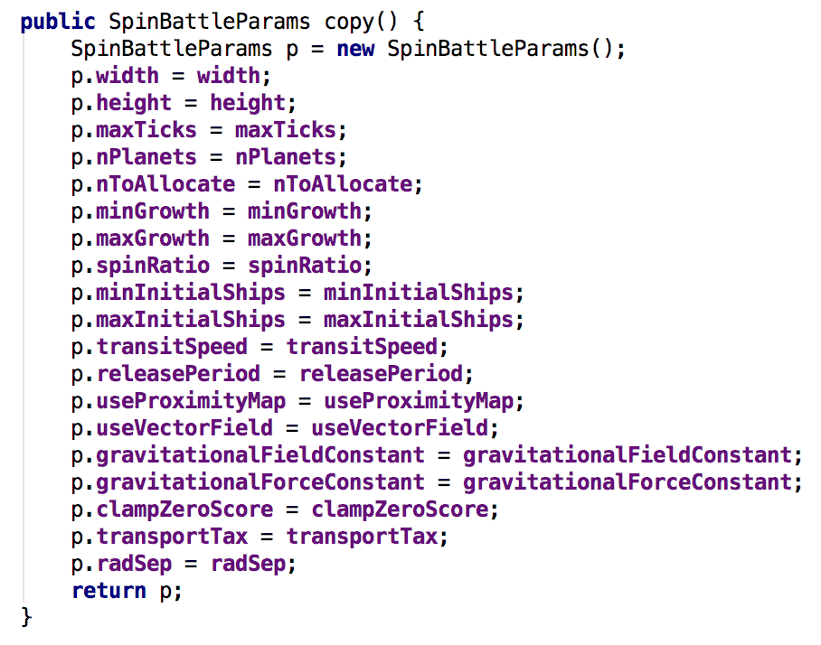
Ideas for Game Variants: Modifying Parameters
Size of game
Speed of transits
Strength of Gravity
Transit Speed
Transport tax
Number of planets
Min separation (radSep)
Most of those shown here ->
…

Slide 4
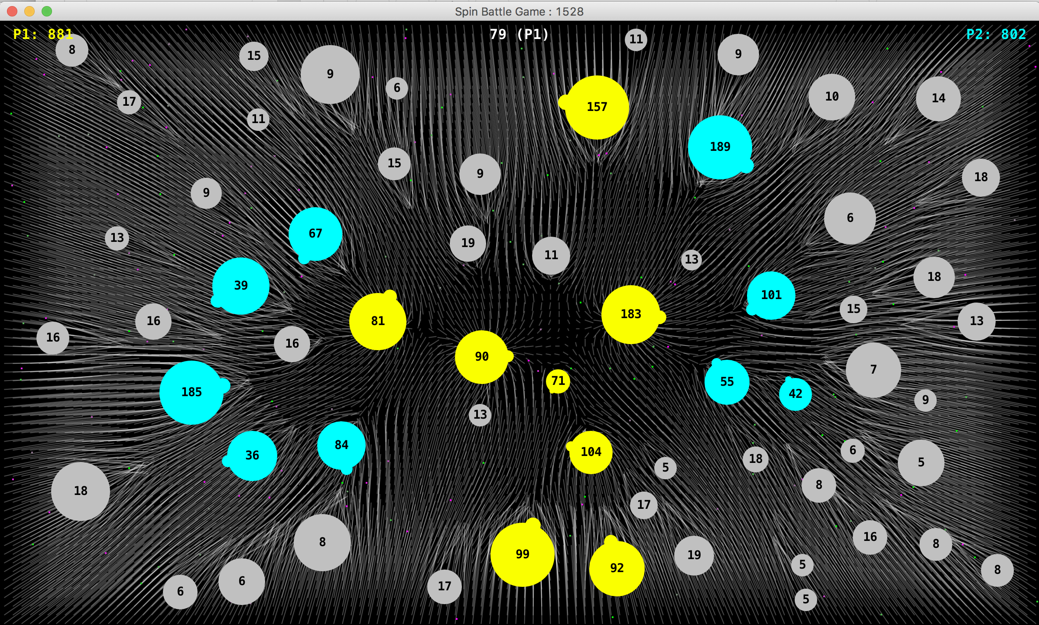
Even Changing the Arena Size May Reward Different Skills (can you guess what else changed here?)

Slide 5
Could also add / modify
Add new actuators: e.g. a Catapult Interface
A flick interface
Other ways of controlling all aspects of Transporter launch and travel
Launch Velocity (speed and direction)
Payload (how many ships to send)

Slide 6
Modify the game rules?
Add black holes
A transporter could disappear in to one to be never seen again
Hence losing all the ships
And making the host planet passive: it could still be invaded, but could not launch an invasion
Add mines:
Colliding with a mine destroys a transporter and its payload
Add ship collisions
A small ship could destroy a ship with a large payload

Slide 7
The above are just a handful of ideas
Many more are possible
But whatever you decide to do, be sure to:
Run a speed test and a copy test to ensure that the game runs quickly enough and that state copying works properly

Slide 8
For discussion
We propose that the interface to the game should not be changed
i.e. all AI agents implement SimplePlayerInterface and interact with the via the AbstractGameInterface
What about accessing the game state to develop heuristics?
We’d need to agree that certain aspects of the game implementation would NOT be changed
This may be ok
But may be hard to generalize across different actuator models
Maybe we should all agree to use a SlingInterface?

Slide 9
Searching for Interesting / Favourable Game Variants
Experiment manually – think of good parameter settings or other mods, and test them as human players
Consider defining an AnnotatedFitnessLandscape and using NTBEA to search for game parameter settings which your bot plays well in

Slide 10
Setting up tournaments
Suggest round robin tournaments
i.e. run like a football league (except with more game repetitions)
Each bot plays each other one N times (suggest N = 10) as P1 and N times as P2
Given P players, that makes P * (P – 1) * N games in total
Question: should the game random seeds be fixed or just picked at random N times
In other words, should the “home” team be able to overfit to the particular set of battle arenas (planet maps)?

Slide 11
Running Tournaments: Giving Each Player the Similar amounts of CPU Resource
Simplest approach is to give each player a fixed tick budget
Make sure that the game state uses a static tick count that is checked before and after each call to getAction.
Another interesting possibility is to use a multi-threaded game runner
Each agents gets a fixed real time budget, and can respond to getAction as often as it likes (the game just carries on at a fixed number of ticks per second)

Slide 12
Ideas for AI Bots
Natural to use MCTS and Rolling Horizon Evolution
Also very natural to tune these using NTBEA to get the best performance you can for your game variant
Also fine to implement your own heuristic agents (providing they use the standard agent interface)
Note: the existing Heuristic Controller DOES NOT
But this style is still useful to prototype interesting opponents
Let’s consider ways in which you may gain a competitive advantage

Slide 13
Boosting MCTS – try tuning / implementing
k
Rollout depth / tree depth
Forward discount factor (to value early rewards more than late ones)
epsilon (the additive term used as the divisor in the NTBEA UCB equation can also be used to implement a type of progressive widening in MCTS)
Recommendation policy

Slide 14
Tuning Rolling Horizon
Everything we’ve already covered in the lab
nEvals, seqLength, mutation parameters, shift buffer
As with MCTS, consider forward discounting
Also consider:
Special methods to find initial seed solution (e.g. simple Markov chains)
Special mutation methods that consider the nature of the action space (e.g. shifting an action in time may be more meaningful than flipping to a different action)

Slide 15
Questions, Discussion?

Slide 16
Assessment
50% of the mark for a working game variant and AI bot
50% in proportion to the number of victories

